Slide 1
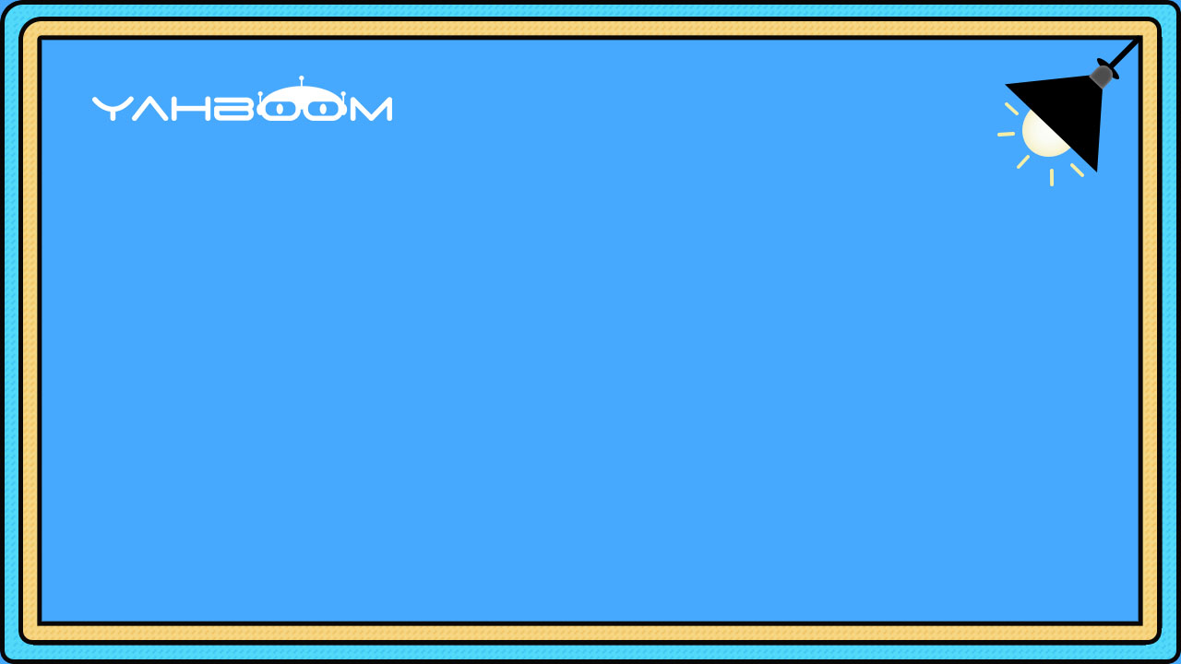

micro:bit programming tutorial
Lesson 3
micro:bit basic lesson 3“Color tracking”
Yahboom micro:bit tutorial

Slide 2
micro:bit programming tutorial
Part1
Part 2
Part3
Part 4
Part 5
Learning goals
Preparation
Search for blocks
Combine blocks
Have a try
Yahboom micro:bit tutorial

Slide 3
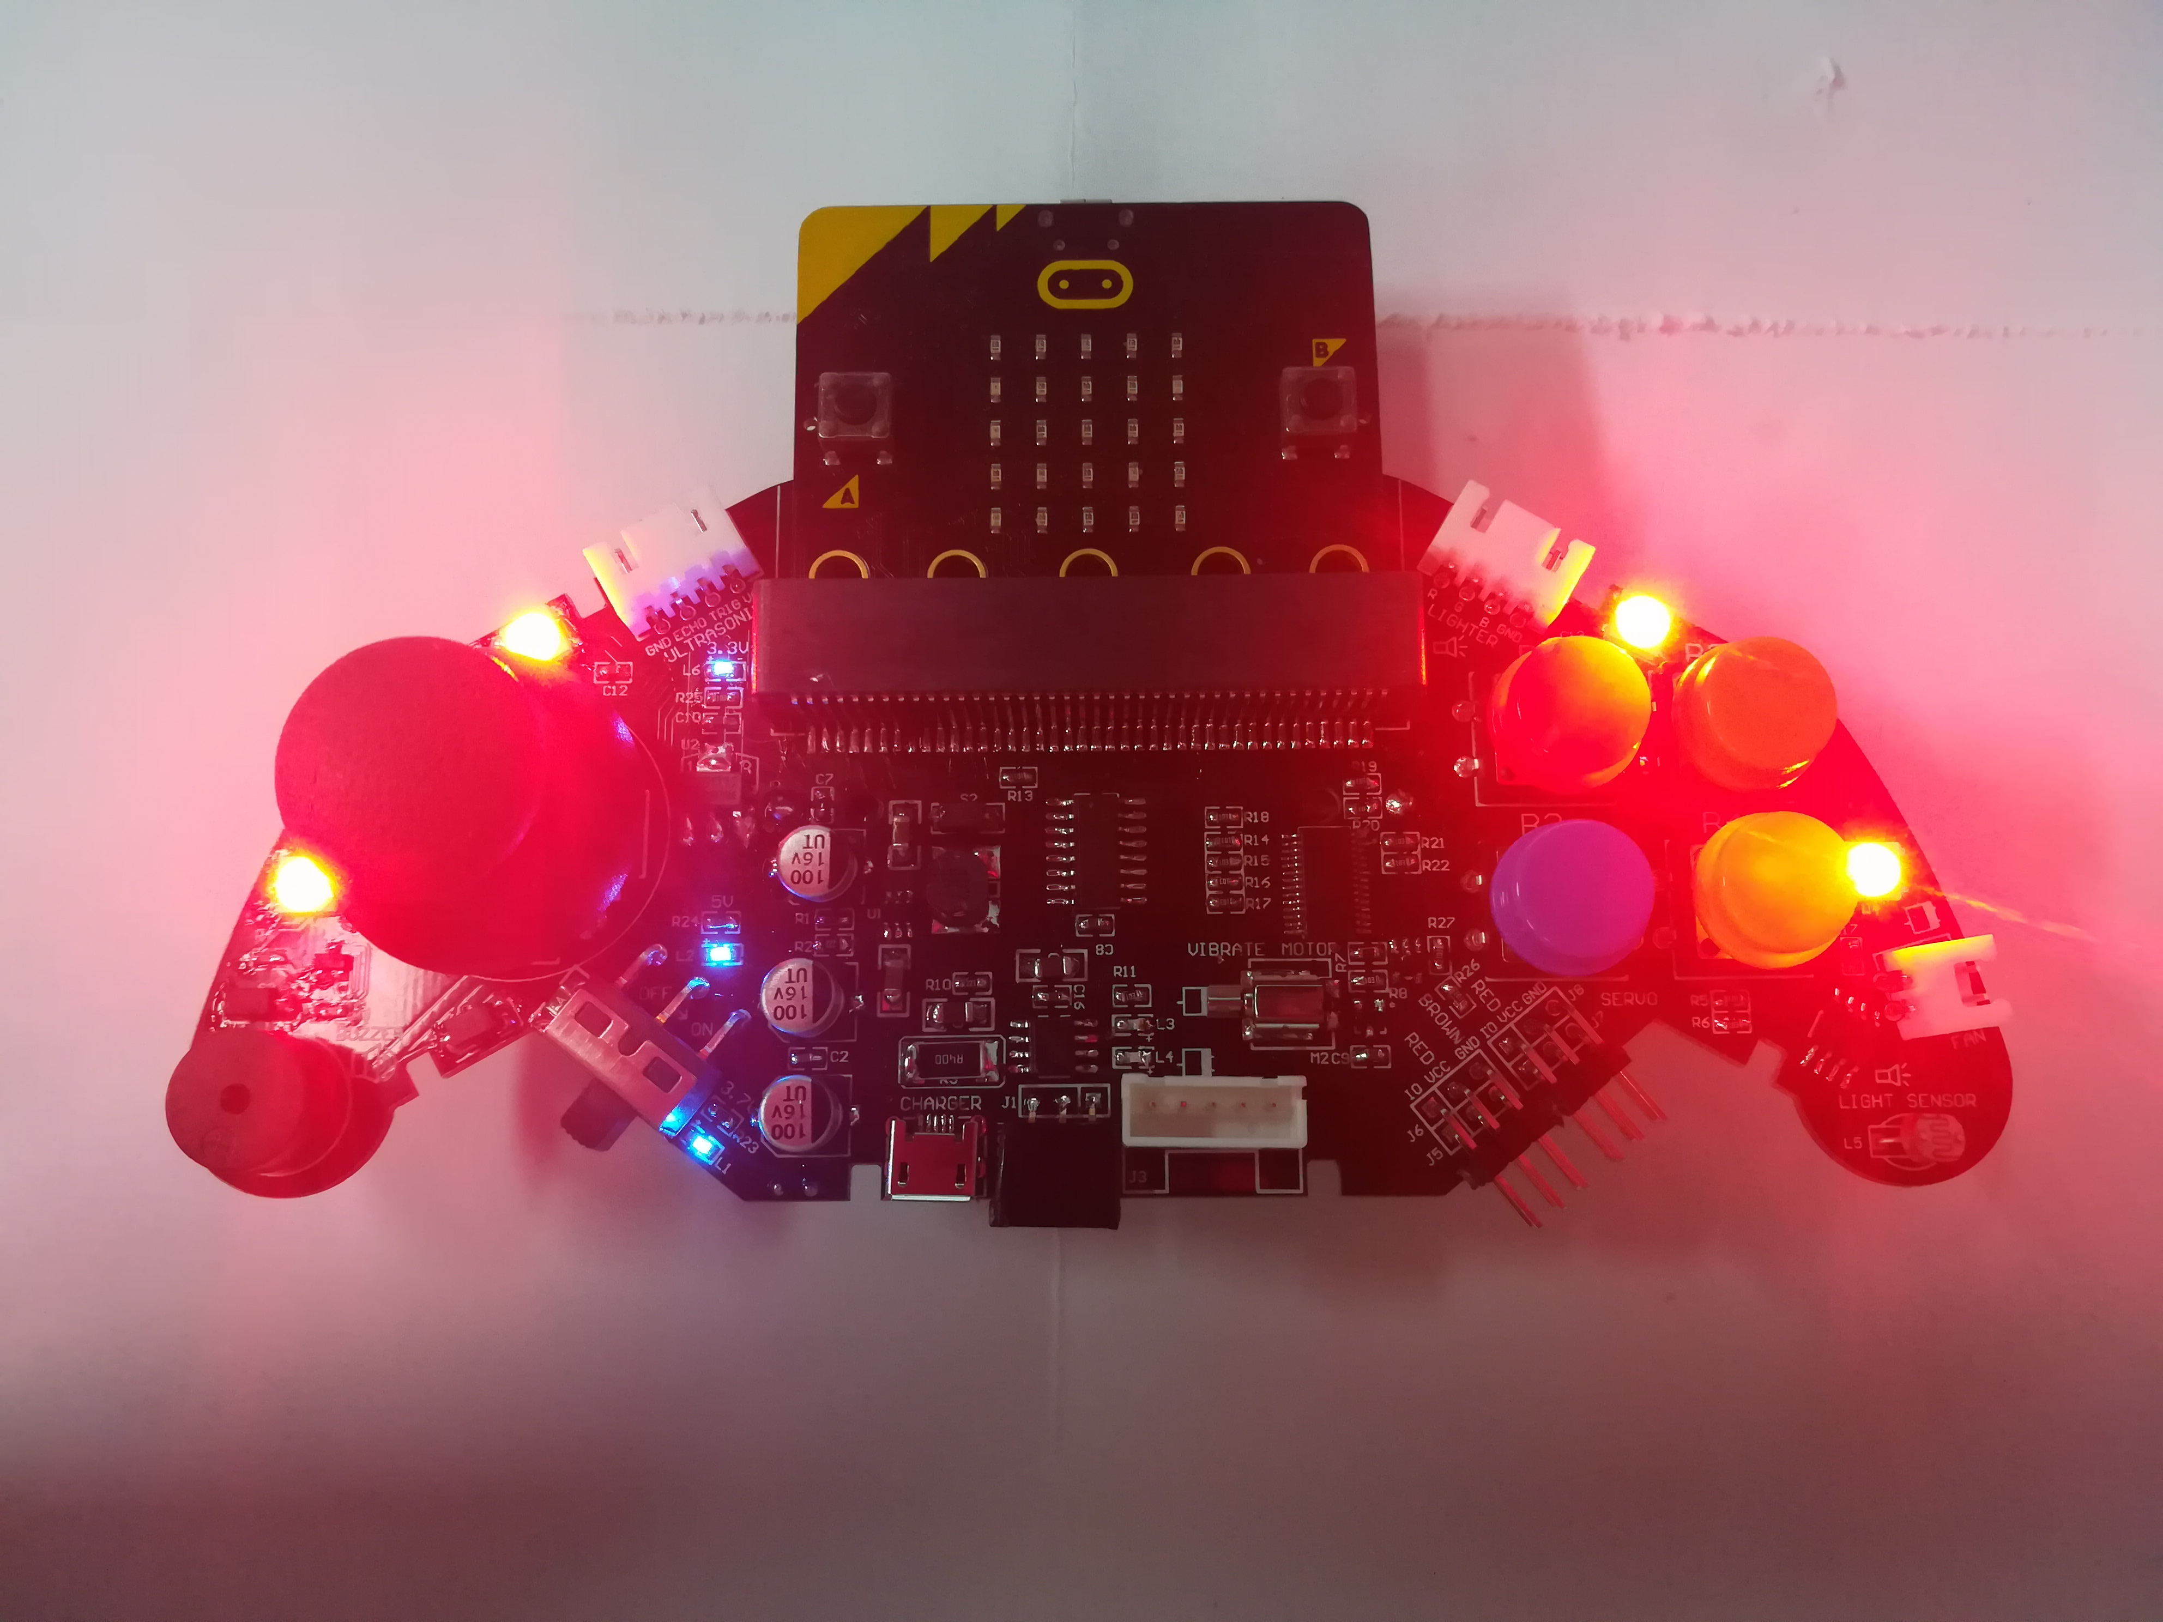
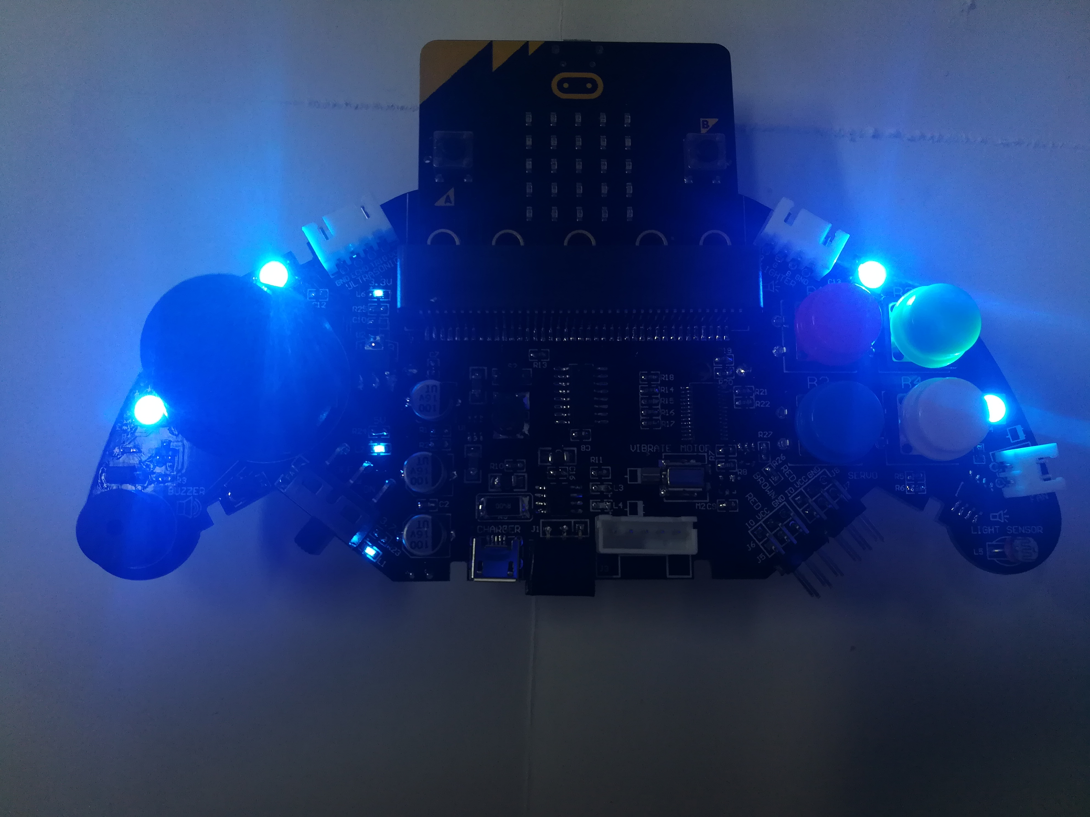
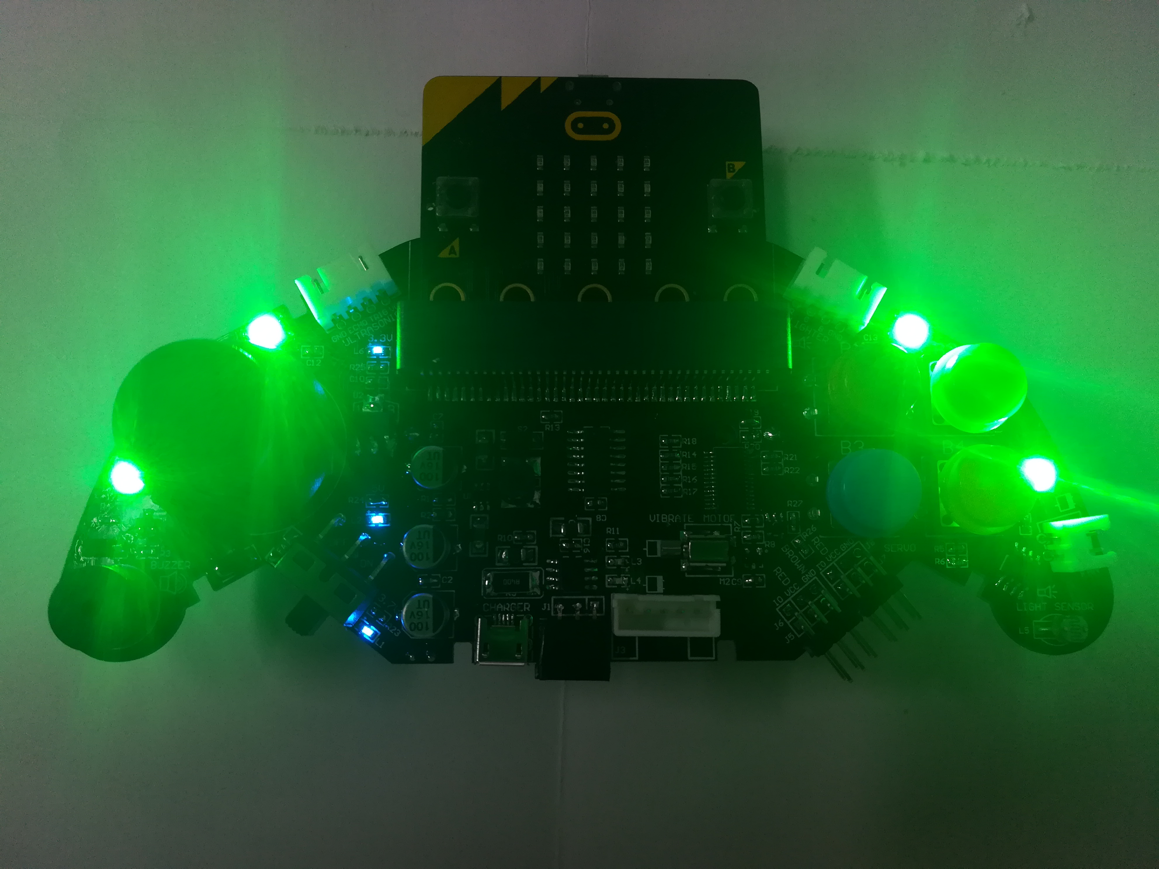
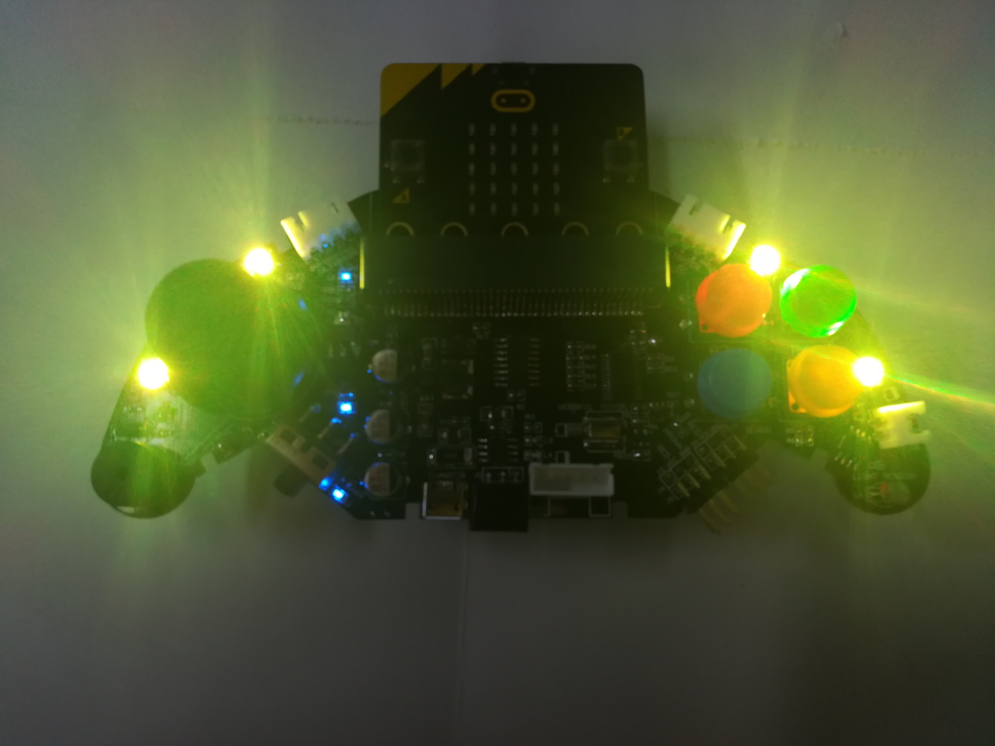
micro:bit programming tutorial
Part1
When we download the program, press the button on the handle. The colorful lights on the handle illuminate the same color as the buttons.
Yahboom micro:bit tutorial

Slide 4
micro:bit programming tutorial
Part2
Hardware：
● 1 X micro:bit Game Handle
● 1 X Micro USB Cable
Yahboom micro:bit tutorial

Slide 5
micro:bit programming tutorial
Part2
Two programming methods
1.Online: Connect Micro:bit to the computer via USB cable, and the computer will pop up a U disk and click the URL in the U disk to enter the programming interface.Enter this URL https://github.com/lzty634158/GHBit to get the package named GHBit.
2.offline：Open micro:bit offline programming software and add GHBit package.Click on "Advanced" and select "Add Package".Enter this URL https://github.com/lzty634158/GHBit to get the package named GHBit.
Note: If you already have a GHBit package, you don't need to add it repeatedly.
Yahboom micro:bit tutorial

Slide 6
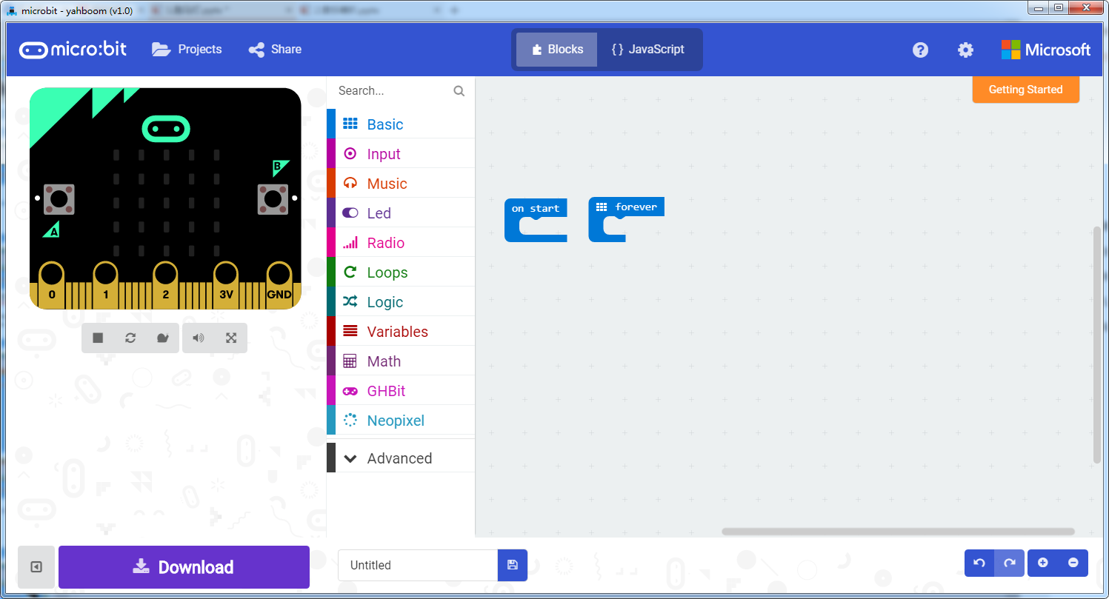
micro:bit programming tutorial
Programming interface
Part3
Yahboom micro:bit tutorial

Slide 7
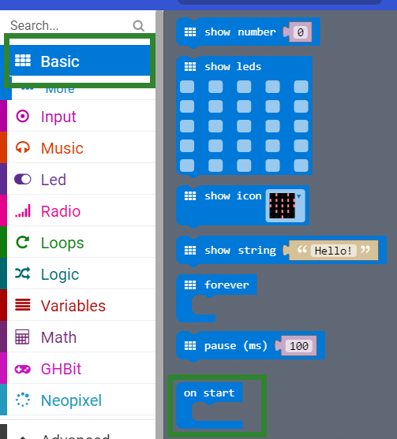
micro:bit programming tutorial
Part3
Start programming
The “on start” building block means that when the micro:bi Game Handle is turned on, the blocks in “on start” start executing and execute only once.
Yahboom micro:bit tutorial

Slide 8
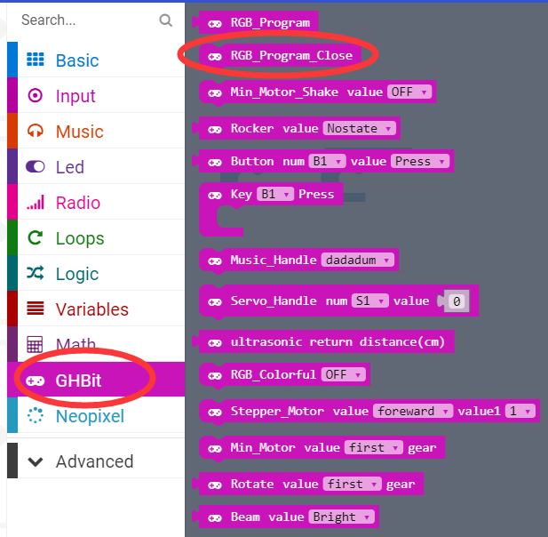
micro:bit programming tutorial
Part3
Turn off the colorful lights.
Note: Every time you complete an experiment on a colorful light, you need to use a program that turns off the colorful lights. Otherwise the colorful lights will remain on.
Yahboom micro:bit tutorial

Slide 9
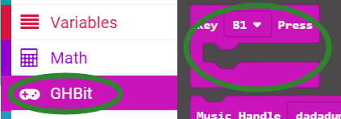
micro:bit programming tutorial
Part3
This is a building block for button detection.
Yahboom micro:bit tutorial

Slide 10
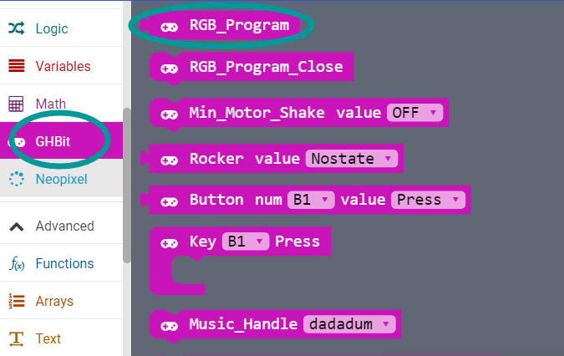
micro:bit programming tutorial
Part3
Use this building block when controlling the lights built into the micro:bit Game Handle.
Yahboom micro:bit tutorial

Slide 11
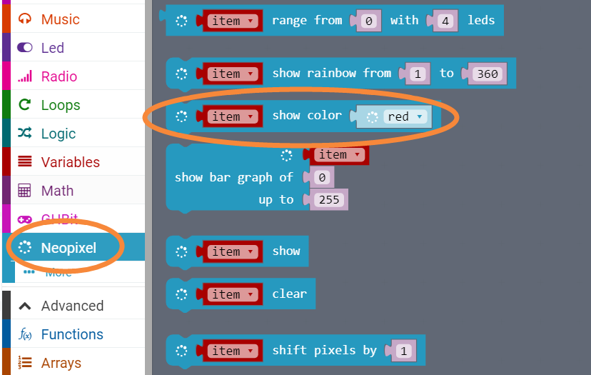
micro:bit programming tutorial
Part3
Select the color that the light on the handle is lit.
Yahboom micro:bit tutorial

Slide 12
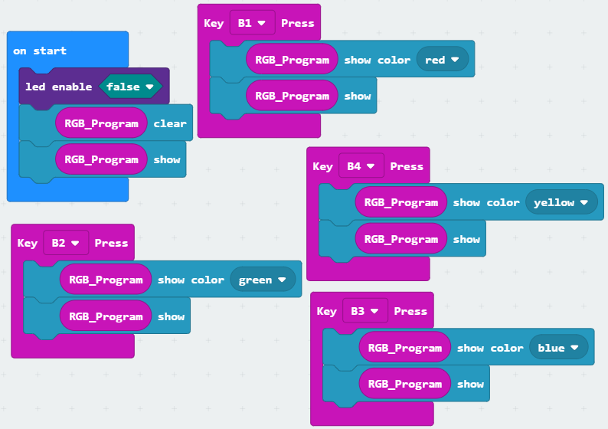
micro:bit programming tutorial
Part4
! Note:
Because the colorful water flow light uses the P4 pin, it is multiplexed with the pin of the micro:bit dot matrix. So we need to turn off the LED during initialization.
This is the complete building block for this course, let's download it to the micro:bit Game Handle.
Yahboom micro:bit tutorial

Slide 13
micro:bit programming tutorial
Part5
Do you learn the course today?
If you learn to do it, give yourself a top quack.
Now give you a homework assignment.
Write a program, when the different buttons on the handle are pressed, the colorful lights respectively perform a light, a running light, a marquee, and a breathing light.
Start your little brain. Try it.
Yahboom micro:bit tutorial

Slide 14
micro:bit programming tutorial
micro:bit
Thanks for watching！
Yahboom
Yahboom micro:bit tutorial

